Slide 1
Using IDS GIST Gift & Deselection Manager for Weeding Books :
How Schenectady is Using It, Anyway
Fall IDS Project Eastern NY Regional User Group Meeting
Oct. 15th , 2012

Slide 2
Begley Library Print Collection as of Fall 2009
76,000 volumes in “Main” Stacks both floors
25,000 vols. in Reference and PS-Z on 1st Floor
51,000 vols. in A-PR on 2nd Floor (including music scores)
Notes:
Statistics at Beginning of Pilot Project, Fall 2009. Only stacks in question are the “main” or central stacks on each floor; peripheral stacks, i.e., JUV, Career, Leisure, Graphic Novel, and Urban Novel collections and Paperbacks, not included.

Slide 3
Pilot Project, 2009-2011
Avg. weeding rate was 8.5 hours per book truck of approximately 100 books each.
Between Nov. 2009-Aug. 2011, Tech. Svcs. weeded 6,000 volumes in Q-TP on 1st floor.
Did not use GIST GDM. We searched the SUNYConnect Union catalog by hand and deleted OCLC holdings one title at a time.
Notes:
We maintained records to provide a benchmark for any future projects.

Slide 4
Begley Library As of Fall 2011
Go ahead for Information Commons
According to preliminary drawings, we need to eliminate all stacks on 1st Floor and one aisle (or range) on 2nd floor
Need to weed and/or shift 42,000 volumes or 55% of the Regular, REF, Scores collections to remaining space on 2nd floor
At current rate, it would take seven years for Tech. Service staff plus part-time helpers to weed collection fully.

Slide 5
GIST GDM
  GDM is designed to manage and streamline library work-flow for processing gifts and evaluating materials for weeding.
  How?
  By automatically gathering useful data for you…using web services data from:
    Amazon.com,
    Better World Books,
    Google Books,
    Hathi Trust,
    Index Data,
    OCLC,
  And by automating services like printing donor letters, or connecting and searching OCLC Connexion
Notes:
Slide taken from IDS Toolkit presentation.

Slide 6
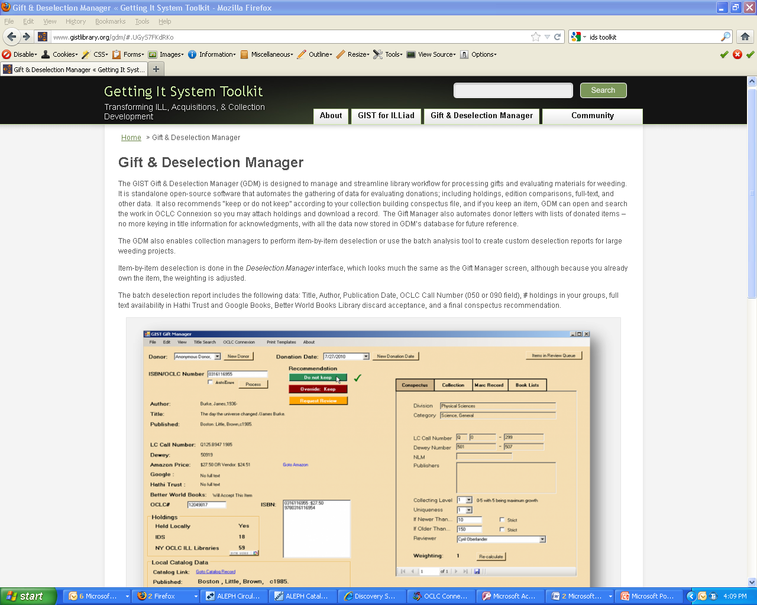
Notes:
Getting It System Toolkit (GIST) http://www.gistlibrary.org/gdm/

Slide 7
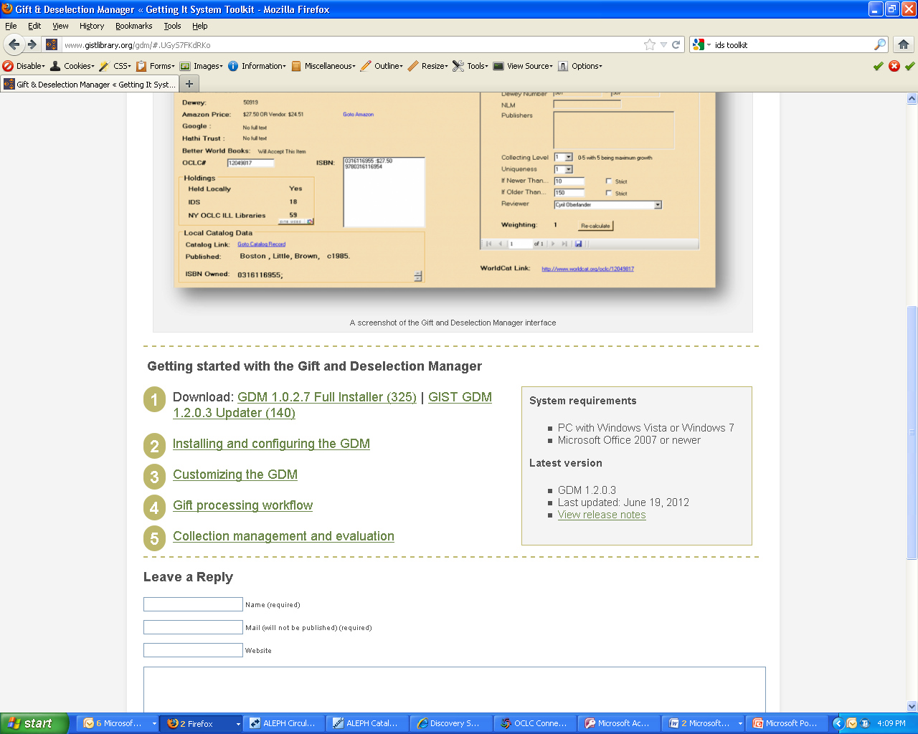

Slide 8
Worksheet for Configuring GDM
CDLC
NAM,VGF,VJK,VJM,VJN,VJP,VJX,VUA,VUE,VXL,VXN,VYD,VZS,XFN,XFR,XFS,XFX,XID,WKM,YRM,YZA,ZWU,E4Y,VJQ,VKM,VML,XFW,XGA,XGT,XGX,XHB,XID,ZRS
SUNY2
BNG,BUF,NAM,UVV,VDH,VGA,VGK,VGN,VND,VOC,VQT,VYQ,VWT,VXV,VVR,VZB,WKM,XBM,XDM,XFM,XMM,XNC,YAH,YBM,YCM,YDM,YFM,YGM,YJA,YJL,YJM,
YKJ,YKU,YLC,YSM,YTM,ZAM,ZBM,ZCM,ZLM,ZMM,YSY,YPM,YOM,ZDG,ZNO,ZOW,ZPM,ZQM,ZVM
W6ThjBtAWZUUa20CFPhtWapavgSfZcqFSFRb1lWTYii1bRombY6hOH0wocnxGGyM34OgZ6udQqX5MAXw
AKIAIJB4ACPNVLYDTO6A
m0Cb0yNZWGmxWZkYFiddNQ+RBJCecGUVP1BZZDjI
Notes:
Actual worksheet for plugging in OCLC Custom Holdings groups and API indexes for GDM.

Slide 9
Tools to Help Beginning Fall 2011
IDS Gift and Deselection Manager.
  Automates searching SUNY Connect Union Catalog
  Automates holdings deletion on OCLC via Connexion
ALEPH Circulation reports imported into MS Access.
  Circulation reports from March 2005-Dec. 2011
  “Dusty Titles” reports from 3/05-8/11, enhanced with award information from RCL Bowker and CHOICE Outstanding titles and other major awards.
Notes:
As a rule, keep titles that have circulated in last six years, plus a few that haven’t based on Dusty Titles report.

Slide 10
Tools to Help
IDS Gift and Deselection Manager.
  Automates searching SUNY Connect Union Catalog
  Automates holdings deletion on OCLC via Connexion
ALEPH Circulation reports imported into MS Access.
  Circulation reports from March 2005-Dec. 2011
  “Dusty Titles” reports from 3/05-8/11, enhanced with award information from RCL Bowker and CHOICE Outstanding titles.
Notes:
Example page of ALEPH Dusty Titles report (custom-56 report: “Circulation Statistics – Items with Zero Circulations”) imported into MS Access report form, arranged in shelf list order. As a rule, for humanities areas, keep titles that have circulated in last six years, plus a few that haven’t based on Dusty Titles report.

Slide 11
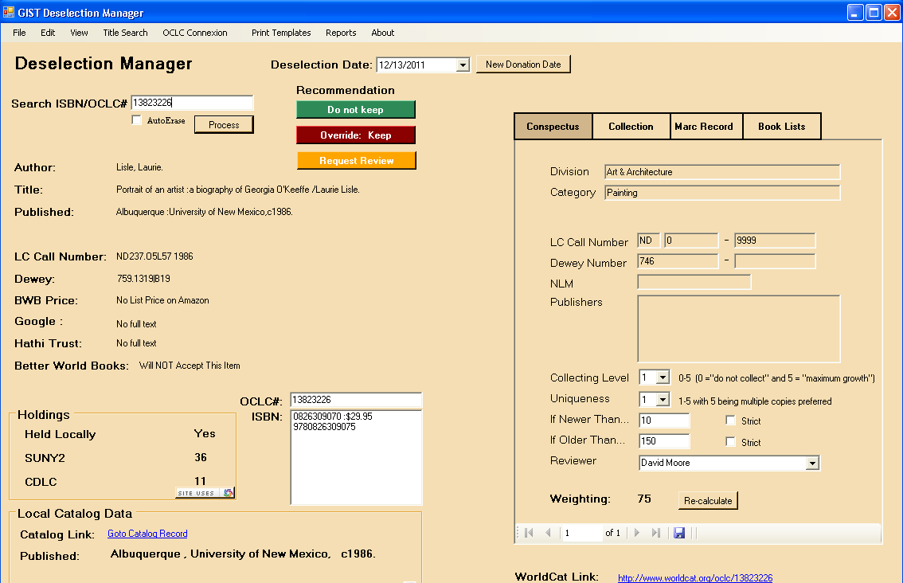
Notes:
Example of Schenectady GIST GDM instance. Click on “OCLC Connexion” tab to retrieve MARC record.

Slide 12
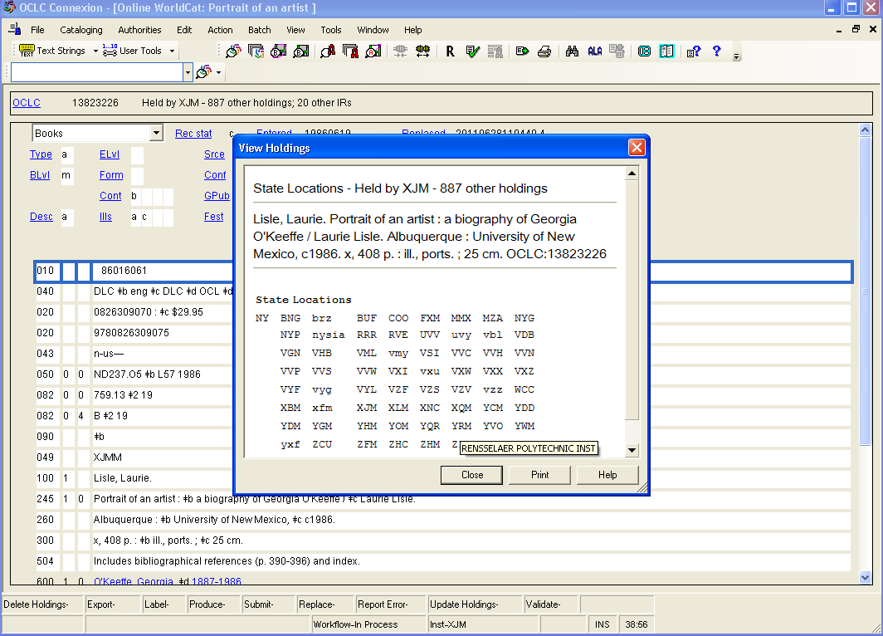
Notes:
MARC record via Connexion with holdings display.

Slide 13
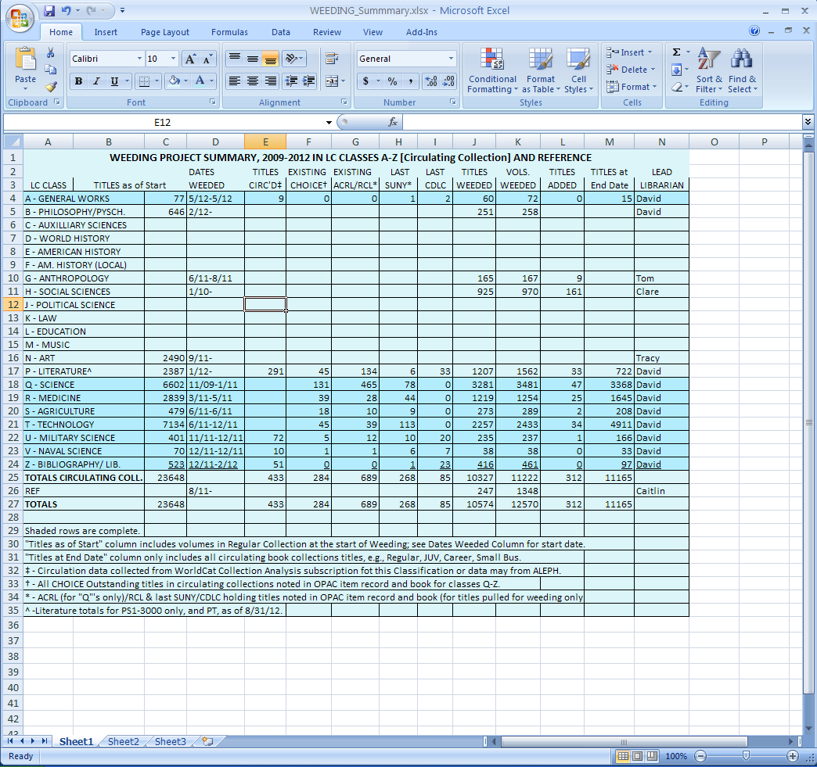

Slide 14
Helpful Links
Getting It System Toolkit (GIST) http://www.gistlibrary.org/gdm/

